Slide 1
Plans for Diamond-II RF

Slide 2
Diamond-II Upgrade
  Diamond-II improves quality of photon beams delivered to users
  Increase spectral brightness
  Increase transverse coherence
  Reduced source size, line-width
  Optimise spectral range
Achieved via reduction in natural emittance, increase in beam energy, new IDs
Magnets
Long Straight
Standard Straight
Mid Straight
~11.3m
~8.3m
Diamond-I super-period
~7.5m
~2.9m
~5.2m
Diamond-II super-period
6 long straights, ~7.5 m long IDs, injection elements
18 standard straights, ~5.2 m long IDs
24 mid straights, ~2.9 m long IDs, 3PW/dipole sources, RF, 3HC, diagnostics, stripline kickers
I. Martin, LER workshop, Oct 2020

Slide 3
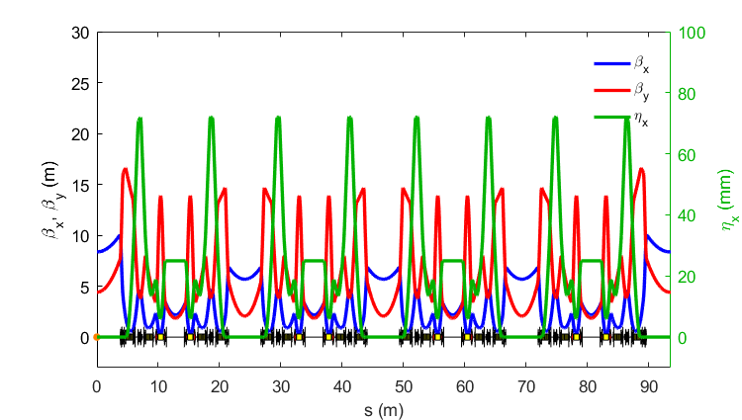

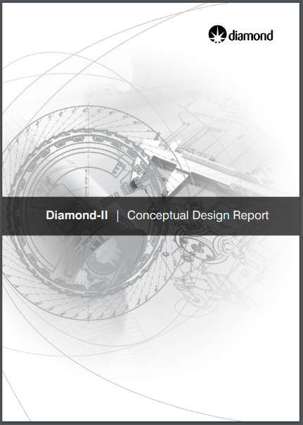
Diamond-II CDR Lattice
  Lattice structure is a ‘Modified-Hybrid 6-Bend Achromat’
  Combining
  ESRF-EBS Hybrid 7BA cell
  Mid-straight sections
  Each cell consists of:
  4 longitudinally-varying dipoles
  2 transverse gradient dipoles
  16 (17) quadrupoles
  12 sextupoles
  2 octupoles
  Emittance (bare lattice)
  2.7 nm.rad (3 GeV)
  160 pm.rad (3.5 GeV)
  Conceptual Design Report (May 2019)
https://www.diamond.ac.uk/Home/About/Vision/Diamond-II.html
I. Martin, LER workshop, Oct 2020

Slide 4
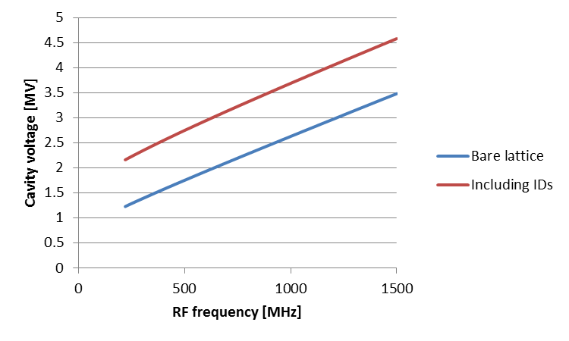
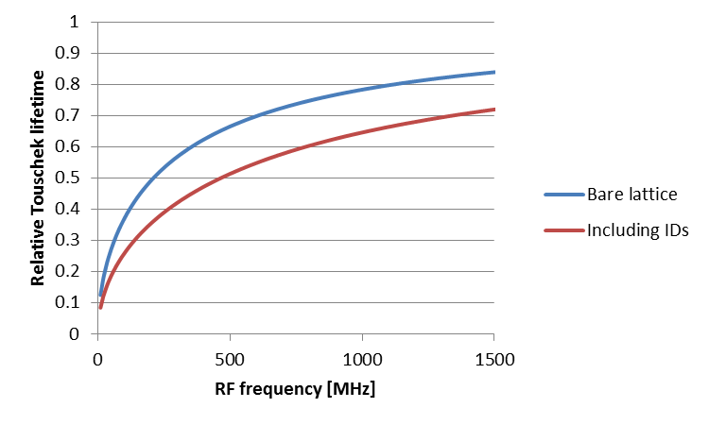


Fundamental RF parameters
Lower frequency minimises voltage requirement
Higher frequency maximises Touschek lifetime
500MHz minimises frequency with limited lifetime compromise
  Multiple cavity designs are available at this frequency
  Several amplifier types can be used
  Preserving Diamond frequency minimises disruption and cost

Slide 5
Precise operating frequency
Lattice design gives f_{rf} = 499.499MHz with h = 934
  How much of the Diamond RF can be used in Diamond-II?
  Amplifiers have broad bandwidth but cavity tuning is more restrictive
Device | Minimum frequency | Maximum frequency | Notes
SR superconducting cavities | 499.5 MHz | 499.8 MHz | Upper limit may be possibly raised by further distortion, but risk of damage is high. Lower frequency may be extended by a smaller amount with further risk
SR normal conducting cavities | 499.3 MHz | 500.1 MHz | Minor further tuning is possible by changing water temperature
Booster cavities | 499.5 MHz | 500.0 MHz
Linac structures | 499.6 MHz | 499.9 MHz | Tuning by water temperature only
Superconducting cavities would operate on the edge of their range
  Further tuning by deformation carries a risk of damage
Normal conducting cavities are suitable for storage ring with no further work
Present booster cavities and linac structures would need to operate at elevated temperature
  Linac operating temperature would be 60°C

Slide 6
Cavity type
 | Superconducting cavities | Normal conducting cavities
Wall power losses | Minimal | Significant
Infrastructure | Complex cryogenic plant Single point of failure | Water cooling
Field gradient | Higher | Lower
Fault tolerance | Any fault will bring down beam | Multiple low voltage cavities can introduce redundancy
Footprint | Large cryostat | Short flange-to-flange distance
Maintenance and repair | Difficult to repair Module must be warmed up Cryostat must be removed Surface treatment required | Simpler
Higher order modes | Less intense | More intense HOM-damped cavities available
Beam port | Large: long taper required | Small: shorter taper

Slide 7
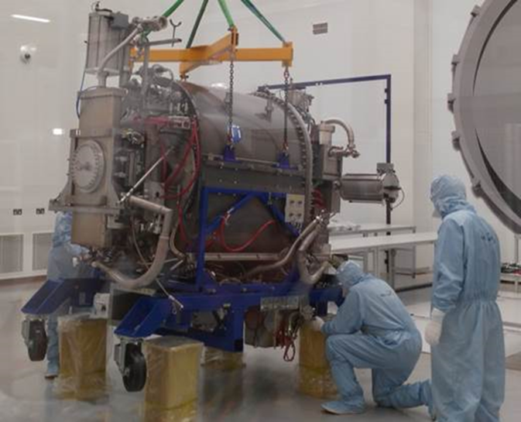
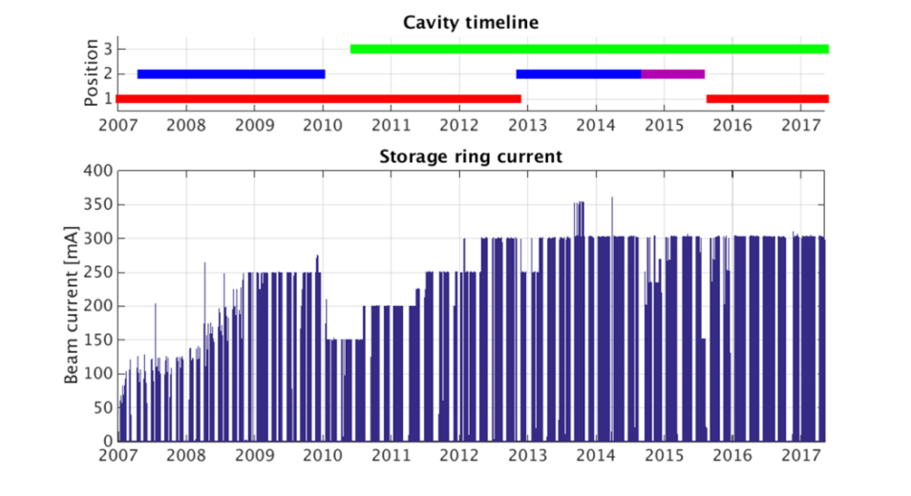
Cavity experience at Diamond
Diamond-I has usually operated with two CESR-B superconducting cavities
Cavity failures have resulted in extended periods of down-time
  Diamond has limited resources to support superconducting cavities
  Cavity repairs have been expensive and can take years
  Cavities must be warmed up before any intervention
Cavity | Failure date | Detail
A | none
B | 2009, 2014 | UHV leak
C | 2006 | Insulation vacuum leak
D | 2015 | Window failure

Slide 8
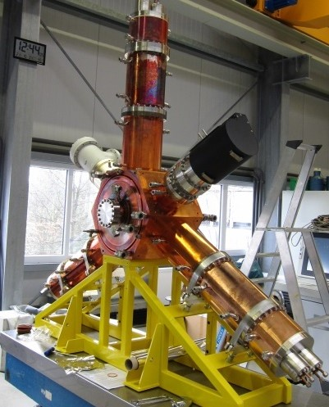
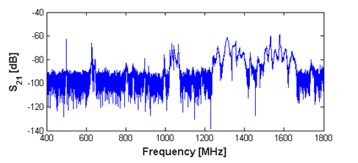
EU HOM-damped cavity
Suitable normal-conducting cavity for Diamond-II
  Resonant cavity in centre
    Radially mounted coupler, tuner and HOM loads
  Simple and easily maintained
  Voltage per cavity will be reduced
  Power per amplifier will be reduced
  Latest iteration of cavity installed at BESSY, Alba and ESRF (scaled for frequency)
    Flanged joint at base of HOM damper waveguide removed to address trapped mode
    Pickup coated at ESRF
  Much smaller longitudinal footprint than SC cavity
    Easier to fit into ring than cryostat of superconducting cavity
  Two cavities have recently been installed in Diamond
Cavity | Coupling | Q₀ | R_{s}
N16 | 5.17 | 33,000 | 3.75 MΩ
N18 | 5.25 | 33,000 | 3.75 MΩ

Slide 9
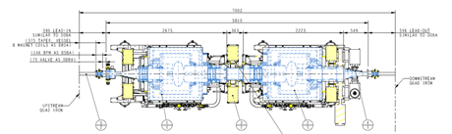
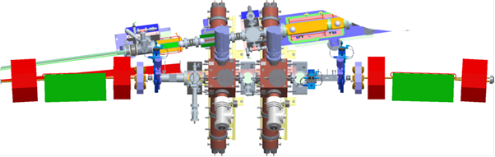
Cavity layout
A new beamline will be installed in what is now the Diamond-I RF straight
Cavities must move to mid-section straights
  Cryostat cannot fit in shorter straight and provide clearance for front ends
  HOM-dampers of NC cavity can fit around a modified front-end support
  Space must be provided for amplifiers
  Easier to fit multiple smaller amplifiers than smaller number of large amplifiers

Slide 10

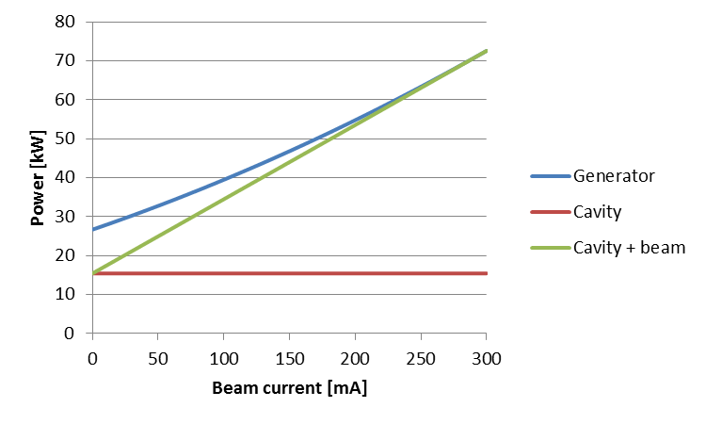
Cavity operating parameters
460kW required for 300mA beam with all IDs
Number of cavities | 6 | 7 | 8 | 9
Optimal cavity coupling | 3.8 | 4.3 | 4.7 | 5.2
Individual cavity voltage | 450 kV | 386 kV | 338 kV | 300 kV
Generator power per cavity | 104 kW | 85 kW | 73 kW | 63 kW
Power dissipated per cavity | 27 kW | 20 kW | 15 kW | 12 kW
Power dissipated in all cavities | 164 kW | 140 kW | 123 kW | 109 kW
Operation with 8 normal conducting cavities
  Reduces voltage per cavity to conservative level
  Minimises running costs
  Gives acceptable total wall power losses
  Allows redundant operation should one cavity fail
  Enables cavities to fit in storage ring

Slide 11
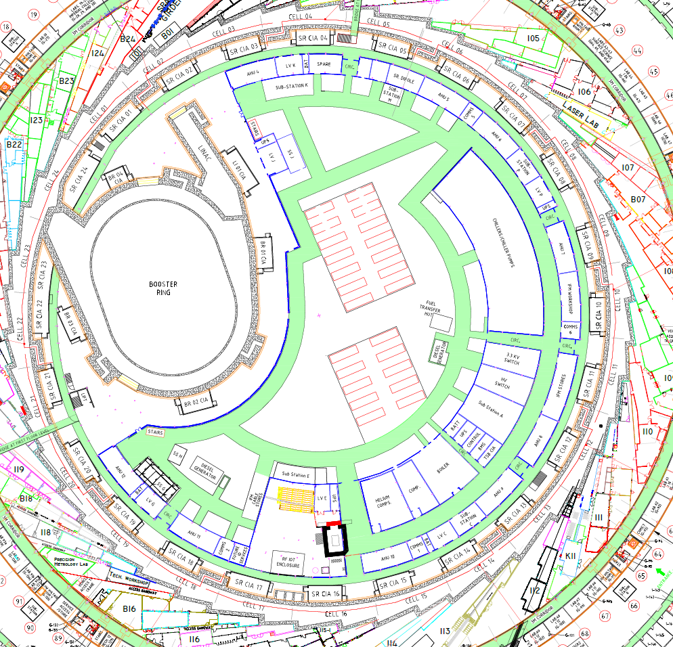
Location of Amplifiers and Cavities
Diamond-I RF is concentrated in one area
  Amplifiers in RF hall
  Cavities in single RF straight
Diamond-II cavities can be distributed in pairs around available mid-section straights
  New beamline can be installed in present RF straight
  Seven mid-section straights are available
  Installation of most new amplifiers is possible with no impact on operating RF
Available mid-section straights

Slide 12
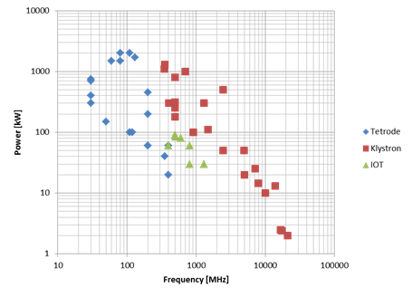
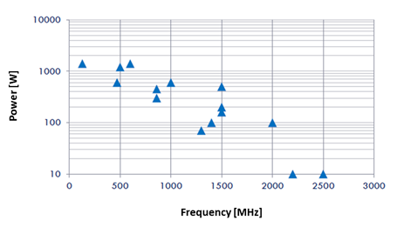
Amplifier type
Vacuum tubes or solid state?
Vacuum tubes
  IOTs or klystrons available
  Proven over many years
  Tens of kV in HVPS
  Limited redundancy
  Obsolescence may become an issue
  Prices are increasing
  Slightly higher efficiency
Solid state amplifiers
  LDMOS power transistors up to 1kW
  Several labs now using SSA
  Typically use 50V supplies
  Easier to work with and less noise on beam
  Extreme redundancy for fault tolerance
  Limited product lifetime but generally replaced by equivalent
  Prices are decreasing
  Slightly lower efficiency
E. Montesinos, LLRF2017

Slide 13
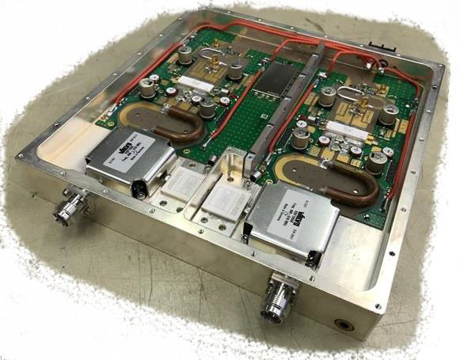
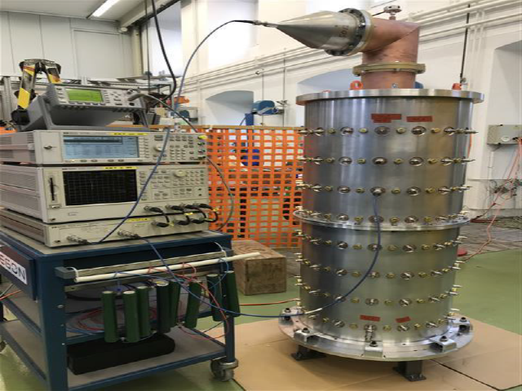
Amplifier design
Well over half of all Diamond faults are IOT related
  There is no redundancy in Diamond IOT amplifiers
  Amplifier must shut down to protect any IOT
  Separate power supplies would be beneficial
  Solid state amplifiers would provide necessary redundancy
All light sources using solid state amplifiers report superior amplifier MTBF
Ampleon BLF578 50 V LDMOS power transistor
2 x 850 W RF out per module
Built in circulator
Lowest possible thermal resistance
128 port RF cavity combiner
Combiner is 99% efficient
Tuneable with >4 MHz 3 dB bandwidth

Slide 14
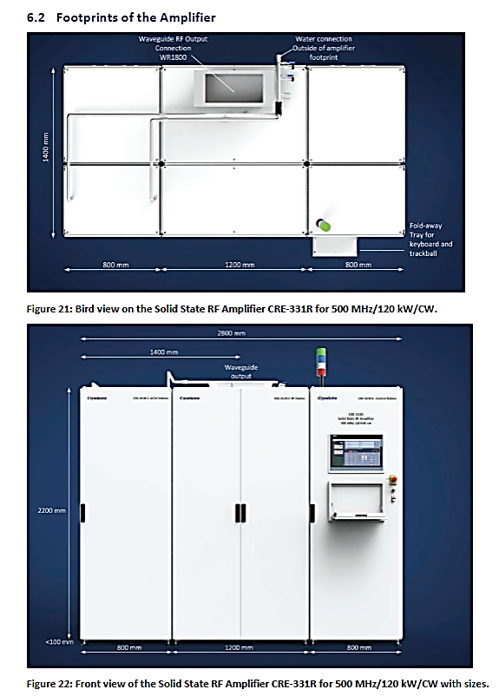
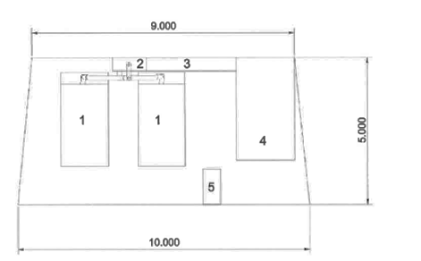
Compact SSA for Diamond-II
Amplifier units
Combiner
Transmission line
Circulator and load
Services
Specification for third SSA for Diamond-I included a requirement to fit into available space between CIAs
  Four tenders received, all compliant
  Supplier of first generation SSAs proposed the largest footprint
Decision made on a range of technical and commercial criteria
  Winning tender was smallest amplifier
  2.8 m x 1.4 m single unit
  DLS to provide circulator and load

Slide 15
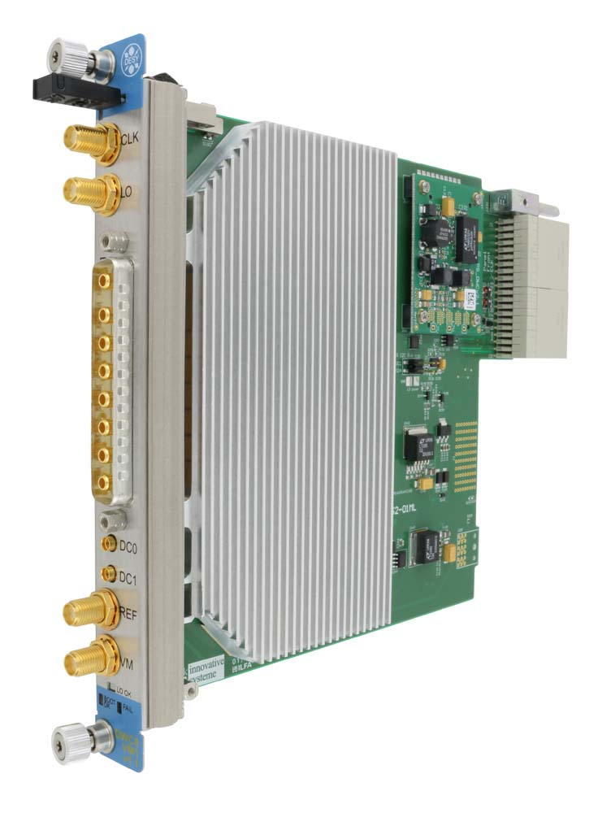
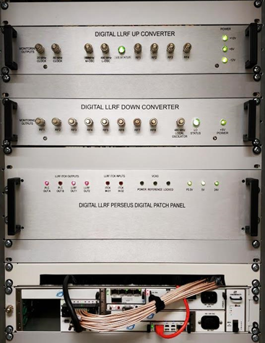
Low level RF
Digital LLRF offers flexibility and adaptability
Using Alba DLLRF in Diamond-I
IQ or polar PI loops of the cavity field for amplitude and phase.
Cavity tuning
Fast interlock handling.
Automatic start-up and conditioning
Monitoring of RF signals
Recording of main digital processing signals for post-mortem analysis
Features
Based on the MicroTCA standard
Perseus 601X advanced mezzanine card with Virtex6 FPGA
16 Channel 14-bit ADCs and 8 channel 16-bit DACs
Developing upgrade for Diamond-II
MicroTCA 4 downconverter/vector modulator RTM
  Manufactured by Struck under licence from DESY
  8 channel downconverter
  1 channel vector modulator
  350 MHz - 500 MHz (DWC8VM1LF)
  500 MHz - 3500 MHz (DWC8VM1)

Slide 16
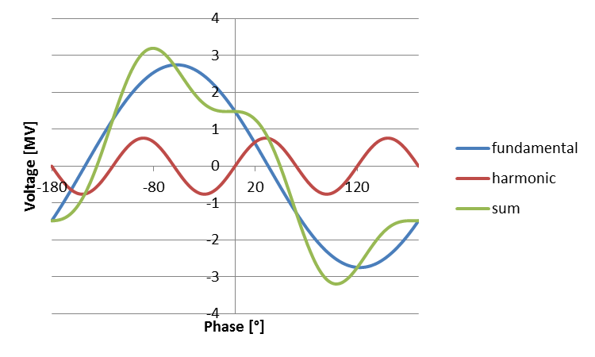
Higher Harmonic Cavity
Higher harmonic cavity is needed to
  Minimise heating
  Alleviate collective instabilities
  Maximise beam lifetime
Proven elsewhere
Considering passive superconducting third harmonic cavity
  CEA/SLS/Elettra design available from industry
  Using cryogenic plant for Diamond
  Detune is almost constant for all conditions allowing wide range of operating currents
  Robinson destabilisation is small and can be damped by fundamental cavity detune
 | Passive NC | Active NC | Passive SC
Pro | Simple | Can be optimised for any beam current | Operates to low current Weaker Robinson instability term
Con | Optimal only at one beam current Strong Robinson instability term Sensitive to fill transients | RF amplifier required Strong Robinson instability term Sensitive to fill transients | Cryogenic system required Narrow bandwidth

Slide 17
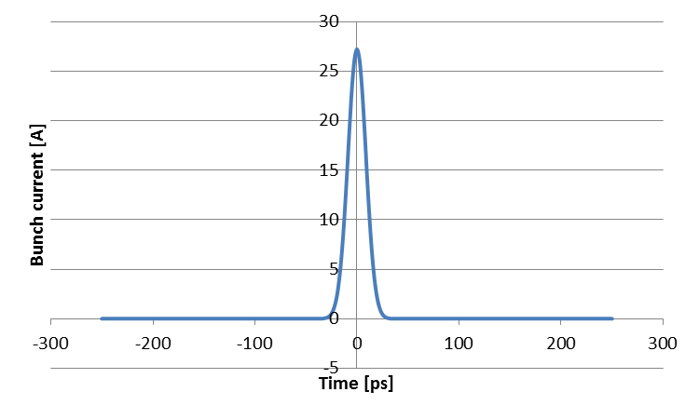
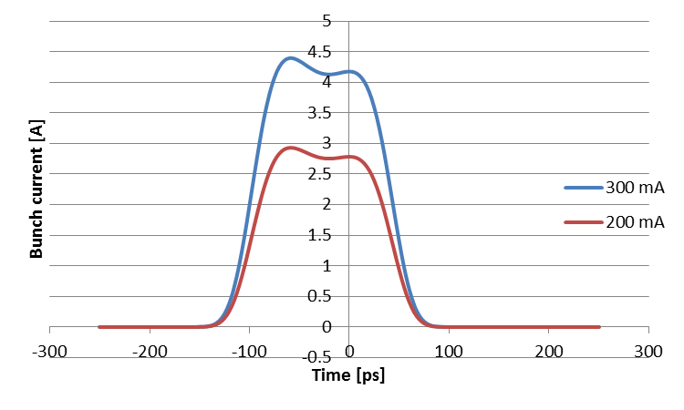
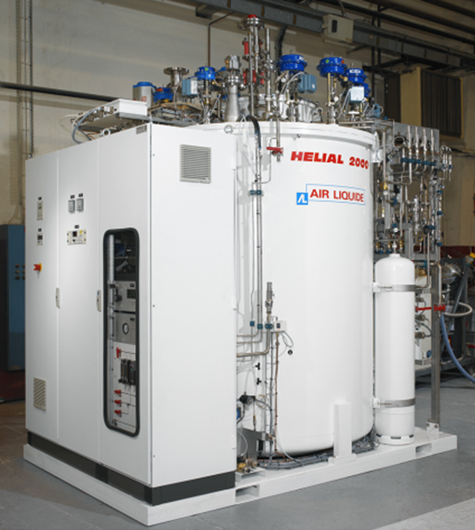
Higher Harmonic Cavity operation
300mA full fill: HHC fully detuned
HHC: 48kHz@300mA 32kHz@200mA
Diamond cryogenic plant
  Air Liquide Helial 2000
  Closed loop refrigerator
  Design performance of 488W
  Measured performance of 500W plus 20 litres/hr
    PSI 3HC requires 50W and 5 litres/hr
  Cavity will fit in mid section straight
    Select location to minimise distance to cryogenic plant

Slide 18
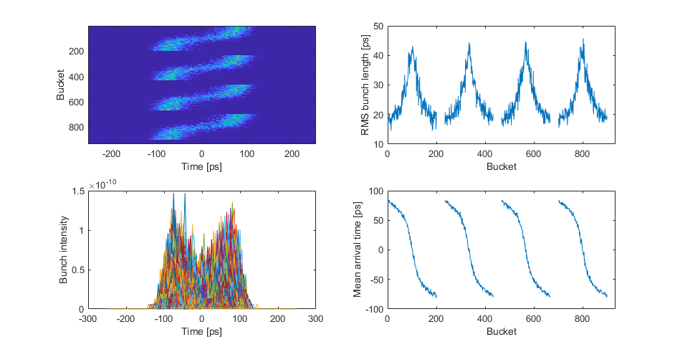
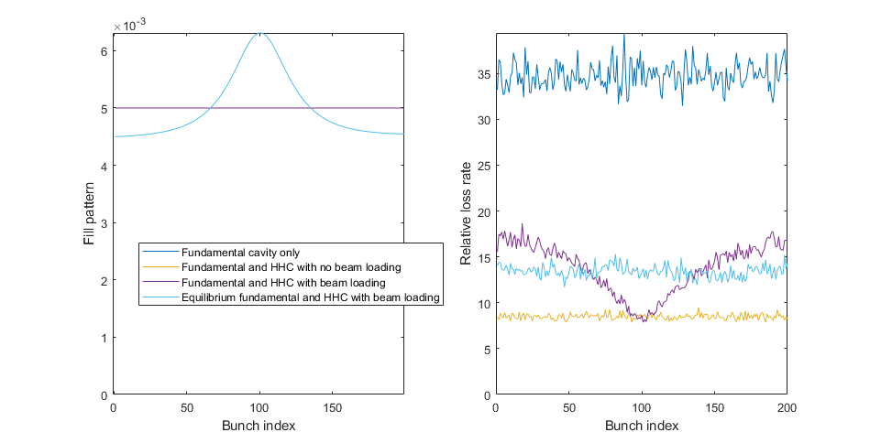
Transients with HHC
Gap in fill pattern induces a transient in HHC
  Unequal bunch lengthening around ring
  Optimal HHC operation for one bunch only
  Effect can be reduced with multiple short gaps
  What is the minimum gap required for ion clearing?
Shorter bunch trains allow multibunch top-up
  Multibunch charge is much higher than single bunch
  Central bunch has longest lifetime
  Effect is self-correcting as lifetime is lower for more populated bunches
  Flat losses can be replaced by a multibunch top-up

Slide 19
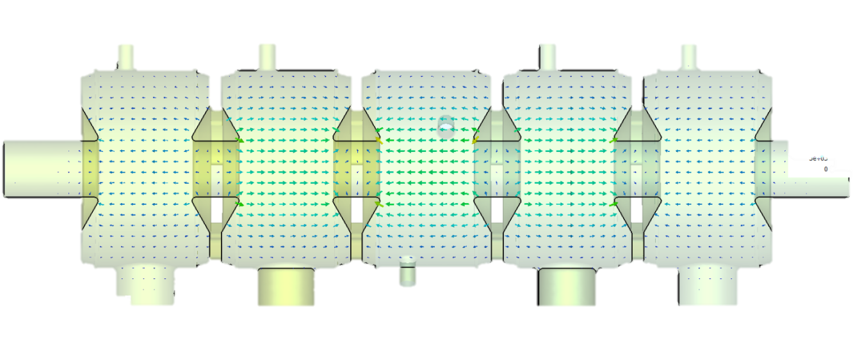
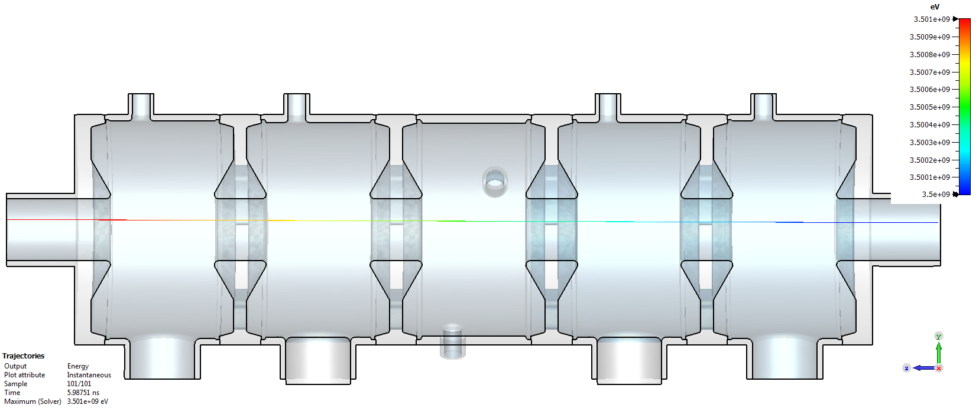
Booster RF
HOM-damped cavities
PETRA 5-cell cavities
Electric field uniformity
Booster ring uses both currently installed PETRA 5-cell cavities
  Can use existing Solid State Amplifiers to power cavities up to 1 MV each
  Space for two EU HOM-damped cavities as back-up
Extracted beam passes off-axis through cavity
  Inner cavity bore can accommodate off-axis extracted beam
  CST calculation shows uniform field across axis
Off-axis trajectory

Slide 20
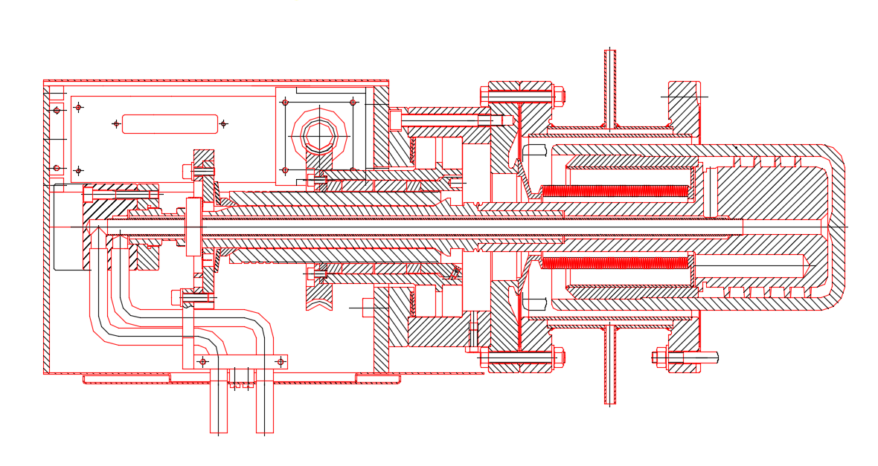
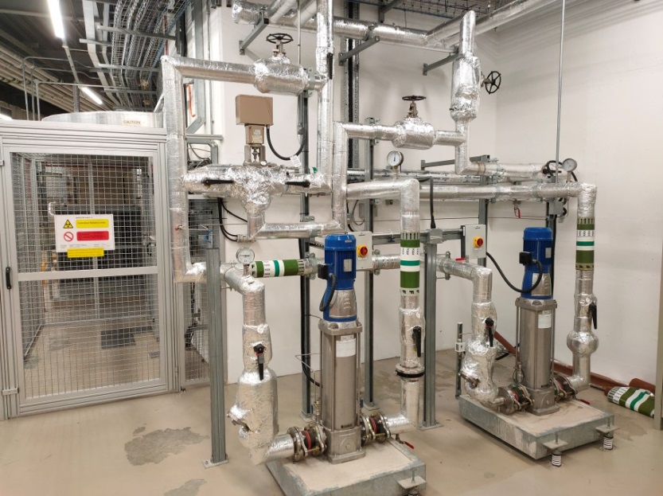
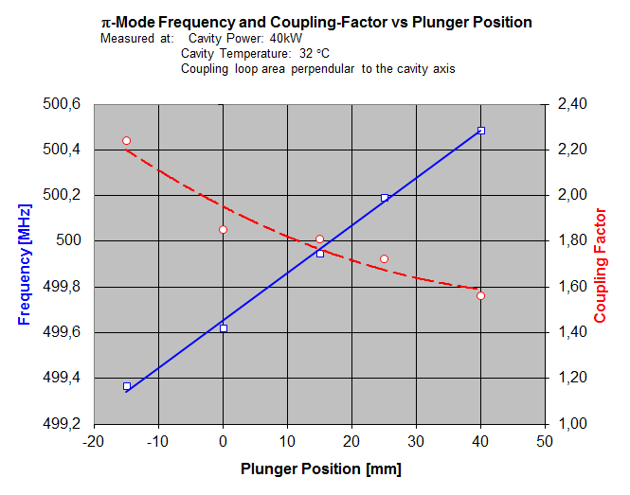
Frequency Issues – Booster
Booster cavity is required to operate near the lower end of its frequency range
  Can extend range to lower frequencies by raising temperature of cavity
    Average operating power is low and cavity self-heating is limited
    Elaborate water distribution system is used to regulate operating temperature
  Can extend frequency range by mounting tuner further off-axis
    Collar between tuner and cavity will allow cavity to operate at ambient temperature

Slide 21
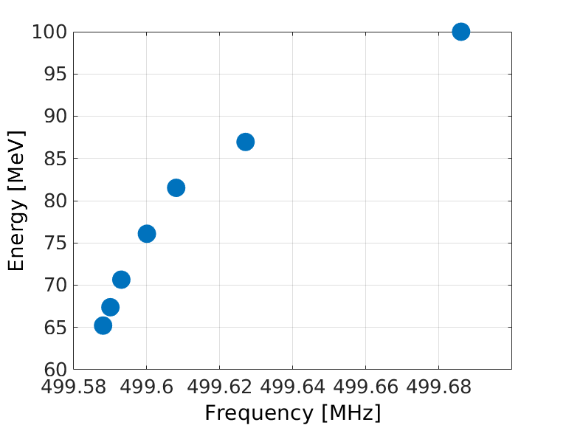
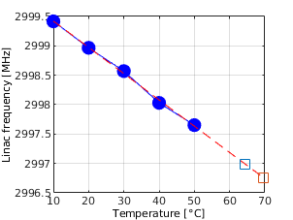
Frequency Issues – Linac
Frequency change impacts most severely on linac
  Bunch charge and beam energy fall off rapidly as frequency moves away from accelerating mode
  Cannot accelerate beam with a neighbouring mode
  Only tuning method is temperature control
  VNA measurements on accelerating structure show that frequency change is roughly 1 MHz for 20°C change
  Operation at 65 - 70°C is impractical
Can build new accelerating structures
  An expensive solution
Asynchronous linac is an attractive option
  Booster and SR at MO frequency
  Maintain linac near present frequency

Slide 22
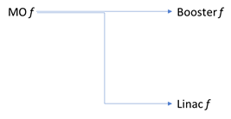
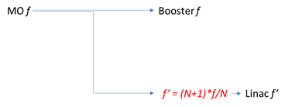
Asynchronous linac operation
Diamond-I global frequency 499.686 MHz
  Extra turns of the booster are used to address sets of 120 buckets in the storage ring
Linac may be operated at a different frequency to booster and storage ring if frequencies are integer multiples of common subharmonic
  Br & SR: 499.499 MHz = 2380 * 209.874 kHz
  Linac: 499.709 MHz = 2381 * 209.874 kHz
Asynchronous operation of linac introduces a second coincidence clock
  Linac-booster sync period 19.06 µs
  Linac-booster-SR super-sync period 2.097 ms
Options for RF generation
  Frequency divider and multiplier/mixer
  Arbitrary waveform generator triggered by subharmonic clock

Slide 23
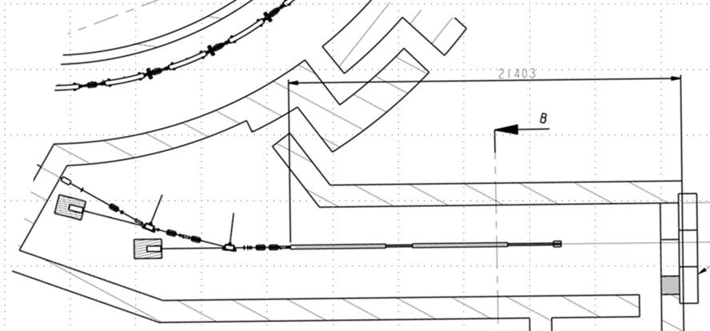
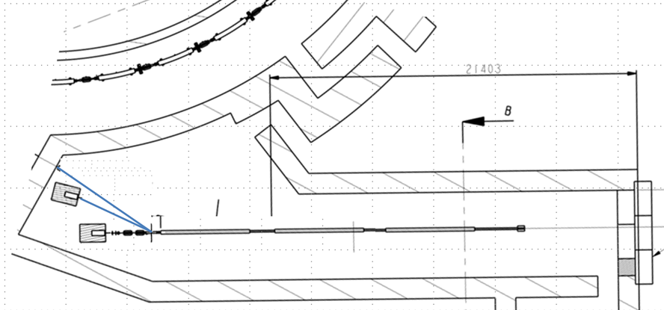
Linac Options
Top- up injection on Diamond disturbs users
  Maximise bunch charge to minimise top-ups
    Studying gun upgrade
  Losses are greatest on injection into booster
    50% to 60% efficiency for SB injection
  Better efficiency with higher linac energy
    Also reduces dynamic range of booster RF and power supplies
Options for increasing linac energy
  Higher gradient
    Modulator upgrade for higher power
    Klystrons will stressed more
    Arc rate will increase
  SLED cavity
    Not optimal for flat-top power generation for multibuch fill
    Arc rate in will increase
  Extra accelerating structure
    Extra costs of third structure and modulator
    Tunnel can accommodate third structure

Slide 24
Diamond-II Timeline
Event | Date
CDR Published | May 2019
1st MAC | Feb. 2020
UKRI International Accelerator Committee project review | Nov. 2020
2nd MAC | Jan. 2021
UKRI decision from Board | Jan. 2021
Decision from Wellcome Trust on grant application | Feb. 2021
Submit Outline Business Case to BEIS | Mar. 2021
Draft TDR reviewed by MAC and SAC | Dec. 2021
Final TDR published | Dec. 2021
CD-2 (UKRI) | Jan. 2022
Submit Final Business Case to BEIS | Feb. 2022
Start of funding and procurement | Apr. 2022
Start of shutdown | Dec. 2025
Resume full User Mode | Jun. 2027

Slide 25
Summary
Conceptual design has been identified
  500MHz RF frequency
  8 normal conducting cavities
  8 solid state amplifiers
  Digital LLRF in microTCA format
  Third harmonic cavity
Next steps
  Resolve linac frequency issue
  Decide top-up scheme
  Finalise third harmonic cavity choice
  Prepare TDR
  Diamond RF Group
  Chris Christou, Pengda Gu, Shivaji Pande, David Child, Peter Marten, Adam Rankin, David Spink, Laurence Stant, Anton Tropp

