Slide 1
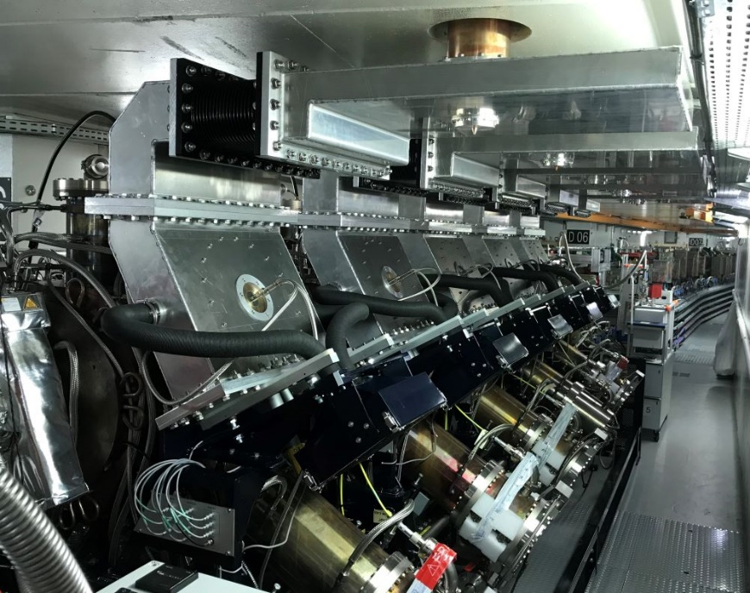
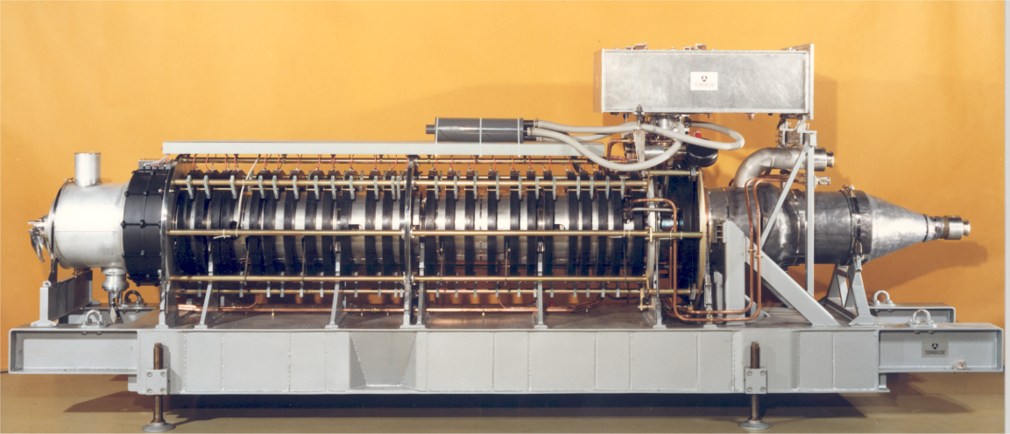
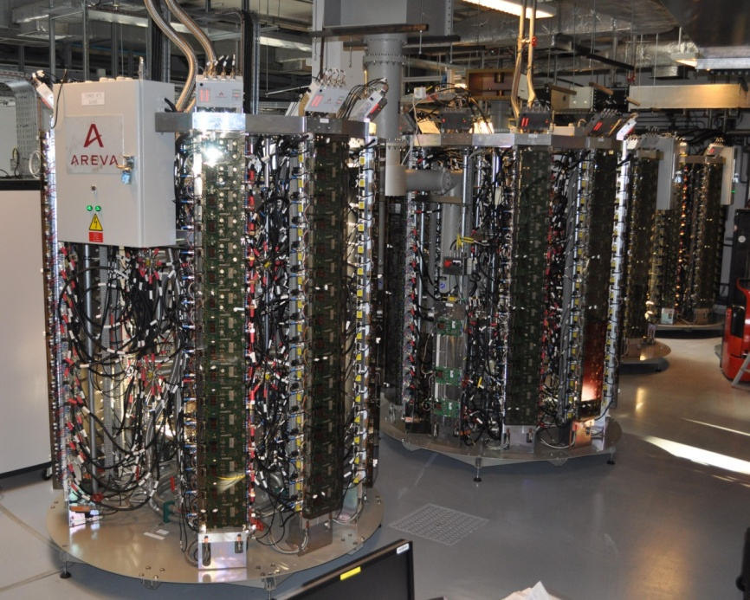
26th ESLS RF Meeting – Elettra
Trieste, 8-9 November 2023
Status of the ESRF-EBS 352 MHz RF system
Jörn Jacob, Pawel Borowiec, Vincent Serrière, Alessandro D’Elia

Slide 2
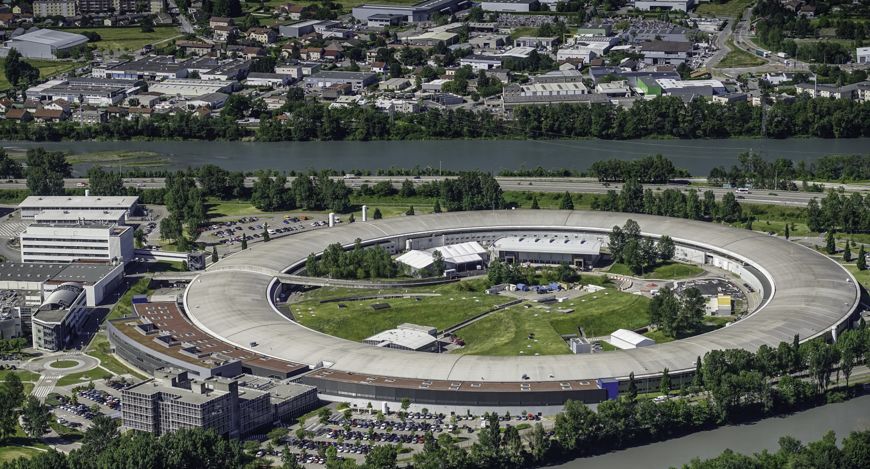
outline
ESRF upgrade: EBS
352.37 MHz RF system for EBS
RF layout
HOM damped ESRF cavities
RF ECO-Mode
RF trips 2023 (so far)
RF projects
Replacement of klystrons by 10 SSAs
4th harmonic RF system

Slide 3
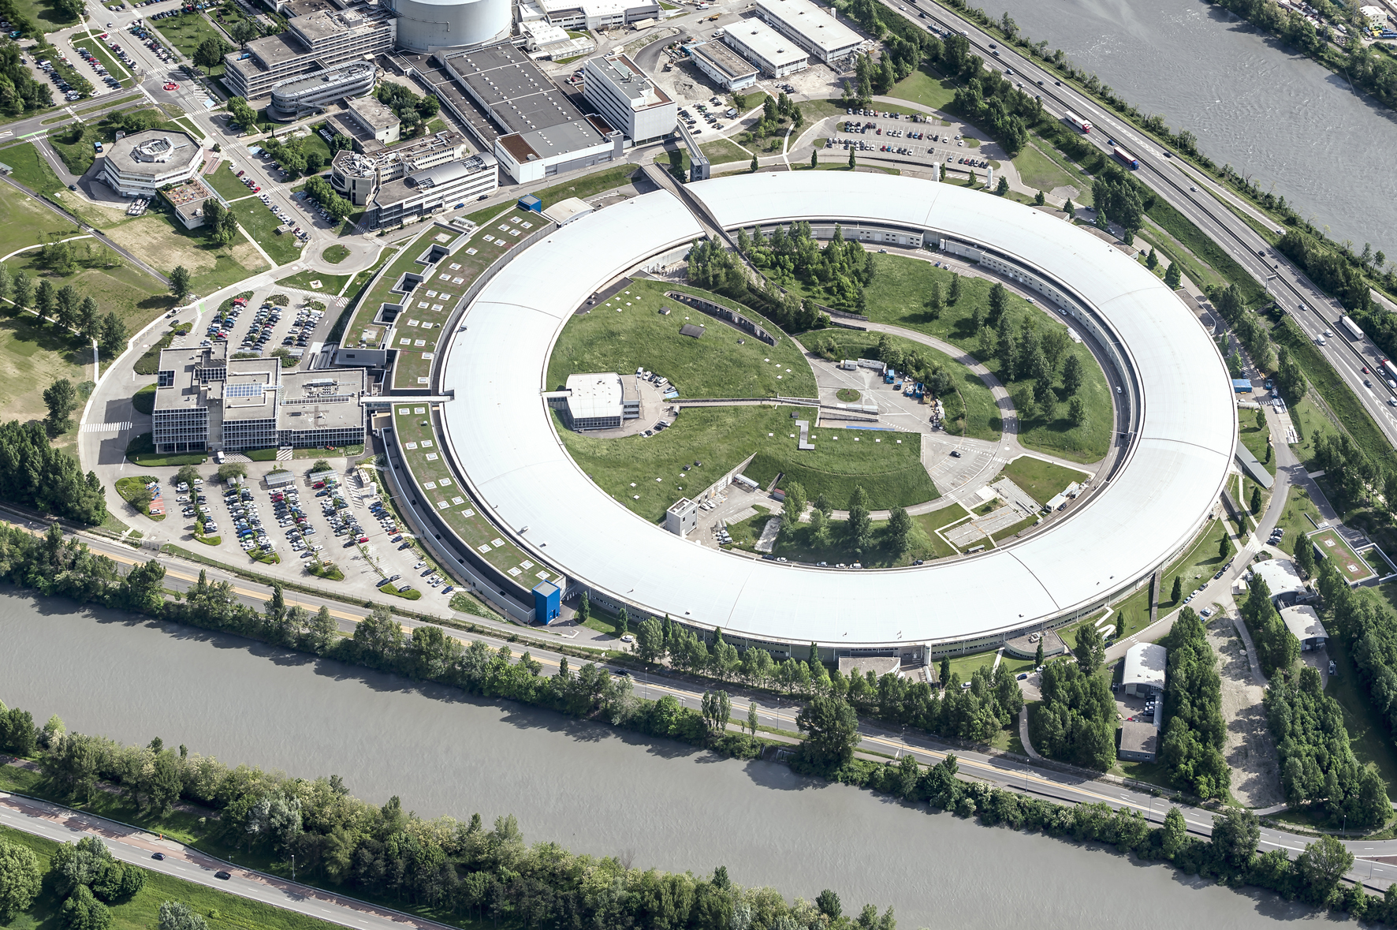
ESRF EBS upgrade
Up to 100 keV X-rays
Circ = 844 m
6 GeV Booster
200 MeV Linac
6 GeV Storage Ring
200 mA
ESRF = First 3rd generation Storage Ring Light Source
1992: commissioning
1994: external users
since then:
many upgrades
brilliance increase by about a factor 1000
2020 New Extremely Brilliant Source: EBS
First 4th generation high energy light source
further brilliance increase by a factor 40
Substantial gain in coherence

Slide 4
EBS 352.37 MHz RF system Layout
EBS Storage Ring
Cell 5
Cell 7
Symmetric 3dB splitting using existing magic T’s
1.1 MW Thales klystron
-7 dB
-7 dB
KLYS 1
KLYS 2
NEW Teststand: in new adjacent building
75 kW
tower
75 kW
tower
75 kW
tower
75 kW
tower
75 kW
tower
75 kW
tower
3x existing 150 kW SSAs
Space for 4th harmonic RF system
Cell 25

Slide 5
MAIN RF parameters for ESRF-EBS upgrade
Total energy loss: 3.2 MeV/turn
Energy loss from dipole radiation: 2.5 MeV/turn
Energy loss from ID radiation, up to: 0.7 MeV/turn
Nominal RF Voltage: 6.0 MV
13 HOM damped cavities: 0.5 MV to 0.75 MV/unit
Nominal stored current: 200 mA
EBS 30 % less total RF power than old machine: ≈ 1 MW at nominal 200 mA

Slide 6
HOM damped single cell cavities 13 units on the storage ring
f_{res} | 352.372 | MHz
Q₀ | 35700 | (measured)
R/Q | 145 | Ω
R_{s} | ≈ 5 | MΩ
Tuning range | -350 / +900 | kHz
V_{acc} nominal / max | 500 / 750 | kV
Coupling β | 2.8
[ESRF design by Vincent Serrière]

Slide 7
RF system – power levels
To give an idea:
Cavity dissipation: P_{c} = V_{acc}² / (N_{cav} x 2R_{s}) = 300 … 400 kW (including reflected power)
Beam power: P_{beam} = I_{beam} x U_{tot}/e, = 500 … 700 kW at 200 mA
(U_{tot} = U₀ + U_{ID} , U₀ = 2.5 MeV/turn, U_{ID} = 0…1 MeV/turn)
Total RF power: = 800 … 1000 kW at 200 mA
AC to RF conversion efficiency: = 30% … 52 %
AC power → f(I_{beam}, U_{ID}): = 900 kW … 1900 kW

Slide 8
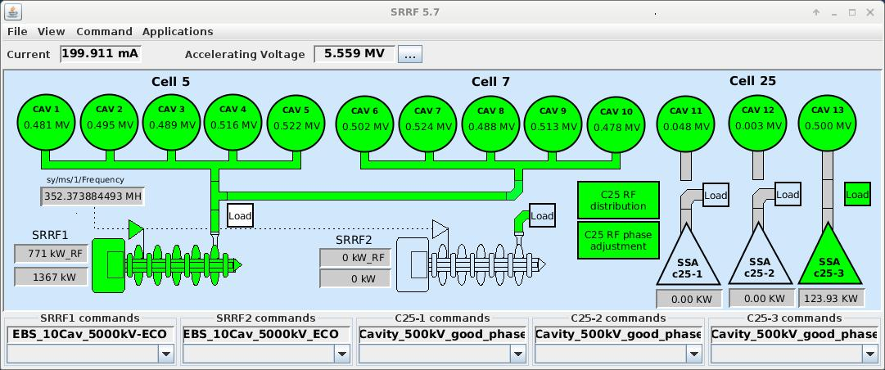
Explosion of Energy cost Autumn 2022 ⇒ RF ECO Mode
P_{AC} = [ V_{acc}² / (N_{cav} x 2R_{s}) + P_{beam} ] / η_{RF/AC}
ECO mode:
Reduction of total V_{acc} from 6.0 to 5.5 MV
Increase AC to RF conversion efficiency:
10 years old 150 kW SSA in cell 25 haven’t yet drain voltage modulation and are operated way below nominal power (90 …100 kW), where the efficiency is low. NB: new SSA from JEMA will have drain voltage modulation and better efficiency at low power like klystrons with anode modulation !
Increase the share of Klystron power by increasing Cav 1 to 10 voltage from 4.5 to 5.0 MV
Operate with only 1 SSA e.g. Cav 13 at 0.5 MV
Gain in efficiency over-compensates adverse effect of lower N_{cav}
RESULT:
200 kW AC power savings at 200 mA
Same beam lifetime for typical ID losses around 0.4 … 0.5 MeV/turn

Slide 9
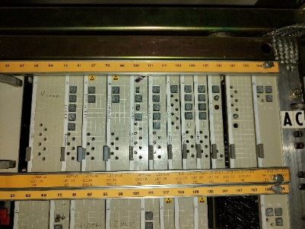
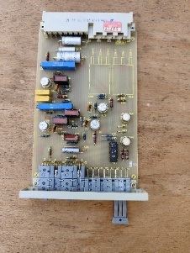
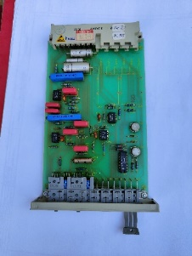
Operational statistic as of 31/10/2023
EEV-4 klystron:
Ion pump #1 – action: disconnected from operation
Breakdown in the input cavity
HVPS:
Internal control issue – loss of the output voltage, no diagnostic available thus external data logger installed in the thyristor room to monitor parameters
Auxiliaries:
Magic Tee0 load flowmeter broken – exchanged
hiccup with the regulation loops of TRA1 -> procedure updated

Slide 10
Cavities in 2023
No signs of degradation nor significant deviations of cavity parameters w.r.t. cavities in other cells have been observed.
Cell 7

Slide 11
Gradual implementation of 10 SSA (each 110 kW RF, max 250 kW AC)
Cell 5
Cell 7
SAT for each SSA connected to RF power teststand, switching between:
cavity in teststand and
load with variable mismatch (EH tuner)
03
04
05
06
07
02
08
09
01
10
10 new 110 kW 352 MHz SSAs
by JEMA France
2024
2026
2026
2026
Dec.
2026
Dec.
2024
2024
2024
2025
2025
Site preparation in good progress:
All within existing buildings
New transformers and power switchgear rooms under existing roof
20 kV and 400 V cables pulled
Installation of pre-fabricated water cooling manifolds and piping in progress
Waveguide layout designed, building adaptation done
LLRF and Control system in progress
Keep Klystron 2 as a unique high power RF source for the teststand
KLYS 1
KLYS 2
Klystron 1 dismounted in Autumn 2026 to free space for last 2 SSAs for cavities 04 and 05
← RF Teststand
3 existing 150 kW SSAs / ELTA
Space for 4th harmonic RF system
13
12
11
Cell 25

Slide 12
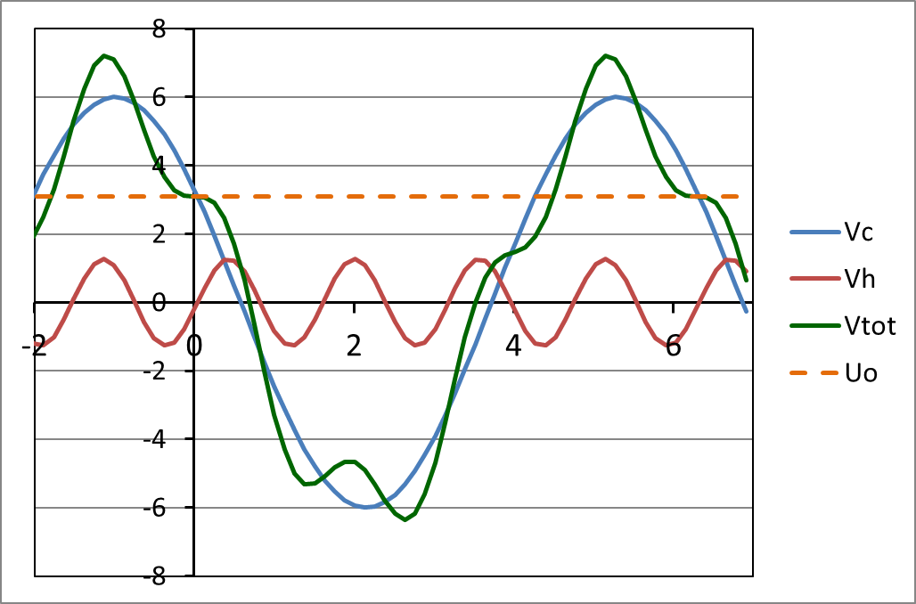
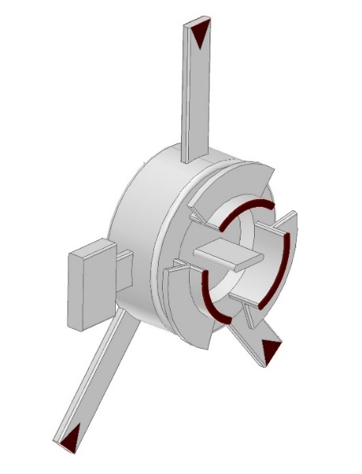
4th harmonic RF system for bunch lengthening
For all modes: Hor. Emit. ε_{z} = 135 pm | Multibunch 7/8 filling | 16-bunches | 4-bunches
Total current | 200 mA | 92 mA | 40 mA
Current per bunch | 0.23 mA | 5.75 mA | 10 mA
Bunch length (calc.) | 13 ps | 31 ps | 37 ps
Vert. Emit. ε_{z} set at | 10 pm | 20 pm | 40 pm
Touscheck Lifetime | 33 h | ≈ 4,5 h | ≈ 4 h
Bunch lengthening by a factor 2.5 to 3
H4 @ 1.41 GHz
1st Priority for high I / bunch (16 bunch and 4 x 10 mA)
Reduced Touschek scattering, IBS and microwave instability:
Factor 2.5 to 3 increase in Touschek lifetime → less frequent injections, reduced loss rate and radiation load
Improved overall stability
Reduced emittance and energy blow up
Room for smaller In-Vacuum ID gaps
Maybe 20 pm → 10 pm vertical emittance in 16b and 4b
Alleviate possible impact from future lattice developments like mini-beta straights
Reduced heat-load and stress of critical chambers, like ceramic chambers or In-Vacuum IDs
Latest harmonic cavity design

Slide 13
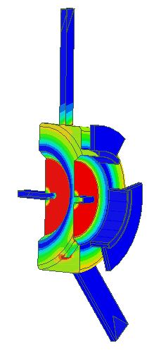
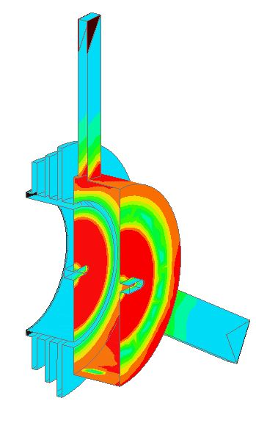
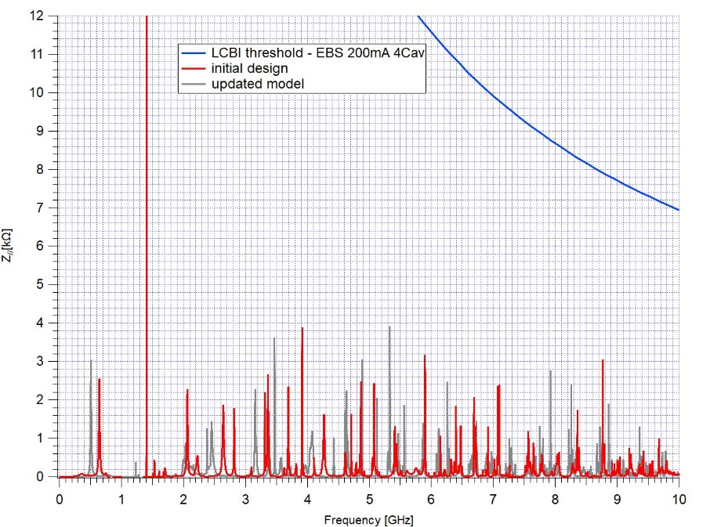
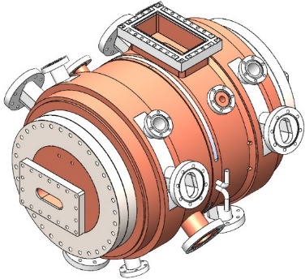
4 single cell TM020 cavities, f =1409.45 MHz - Latest design evolutions
Initial design: V_{hhc_tot} = 1.35 MV → V_{hhc} = 375 kV/cavity
NEW Requirement: Also overstretching operation:
V_{hhc_tot} = 1.65 MV → V_{hhc} = 413 kV/cav
1 Ferrite Loaded Coaxial Line for LOM (HOM) damping with 3 stub filters to fully decouple 1.4 GHz TM₀₂₀ accelerating mode for TEM & 3 TE higher modes with cut off at:
F_{c-TE11} = 370 MHz
F_{c-TE21} = 746 MHz
F_{c-TE31} = 1100 MHz
F_{c-TE41} = 1500 MHz (evanescent at 1.4 GHz)
In both cases - 3 HOM dampers for TM_{m2p} modes and a few other HOM…
3 Ferrite Loaded Waveguides for LOM (HOM) damping with only 1 stub filter → simplified stub tuning, to fully decouple 1.4 GHz TM₀₂₀ accelerating mode for 1st waveguide mode with cut off at:
F_{c-TE11} = 867 MHz
F_{c-TE21} = 1734 MHz (evanescent at 1.4 GHz)
(H-Fields)
 | R/Q [W] | Q | R [MW] | Vcav [kV] | Pcav [kW]
Initial design | 44 | 33500 | 1.47 | 375 | 48
New version | 45 | 40500 | 1.82 | 413 | 47
[Vincent Serrière]

Slide 14
HarmonLip 2024
2nd HarmonLIP workshop
19th and 20th March, 2024 at the ESRF.
Workshop organized within the HarmonLIP (Leaps Internal Project)
Aims to foster information exchange and joint research efforts amongst the LEAPS members for the further development of harmonic cavity/bunch lengthening systems for present and future ultralow emittance storage rings.
Save the date !

Slide 15
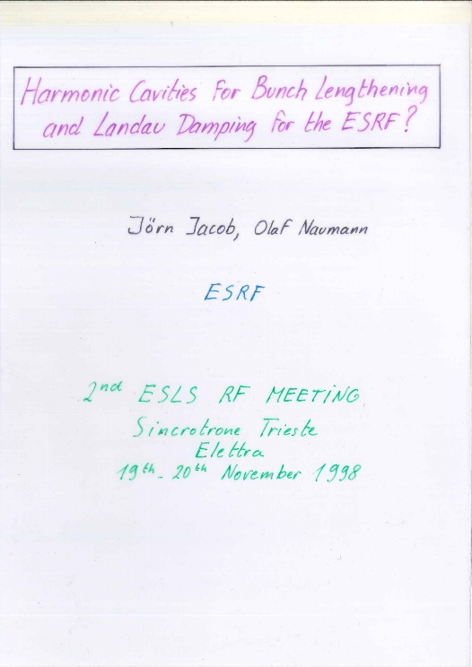
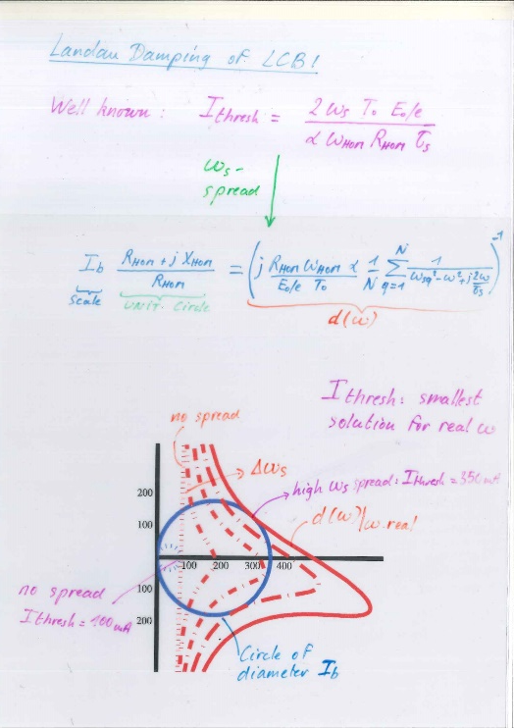
ESLS RF: An Exciting story of technical and scientific exchange
My first ESLS RF meeting: 1998 at Elettra !
Slides still hand made
Harmonic RF already a subject
Closing the loop today at Elettra !
Power point since long
Harmonic RF still or again an important subject
I will retire coming July 2024:
It’s my last ESLS RF today
And it’s time to say:
Farewell to all of you !
Jörn

Slide 16
Many thanks for your attention

